Slide 1



Help Desk
14th Dec 2022
Notes:
Need to change

Slide 2

Agenda
Problem Statement
Solution Capabilities
AI Based Recommendation
Workflow
Admin - Workflow
Support Team - Workflow
Technical Architecture
Implementation
Security
Future Scope
Q&A

Slide 3
Problem Statement
Notes:
Need to change

Slide 4

Our understanding of Scope
Agenda
Help Desk is a tool which will be used to provide a user friendly interface to the employees to raise and track there issues.
1
2
Workflow Management Services
Resource Assignment
Workflow Tracking
Alerts, Notifications, Reminders
Workflows
Monitoring and Optimization
Ticket Management Services
Ticket creation
Ticket Assignment
User conversation

Slide 5
Alpha Team’s vision for Help Desk
1
Simplify
Optimize
2
Enhanced workflow, Ticket management capabilities
Seamless integration through API layer
Agile, efficient, lean and optimized ticket management tool.
3
Intelligent
Leverage Artificial Intelligence capability to drive optimal ticket assignments.
Ticket severity recommendation
Notes:
Drop factspan
cloud data engineering and strategic analytics -

Slide 6
Ticket Management - Demonstration
Notes:
Need to change

Slide 7
Solution Construct
Ticket Management
Workflow Management
Administration
Secure Hosting
Exception Identification
Workforce Management
Help Desk is a customizable ticket management system with user management and workflow management features
Modules
Configuration & Administration
User Management
Ticket Management
Workflow Management
Monitoring
Application will be enabled with AI features facilitating the support admin to take intelligent decisions for ticket assignment and monitoring
AI Models
Ticket Assignment Model
Issue Identification Model
Progress & Forecasting Model
Application can be deployed on On Premise or Cloud platform
Notes:
Drop factspan
cloud data engineering and strategic analytics -

Slide 8









Solution Capabilities
User Management
Ticket Management
Workflows
AI Features
Quality & Security
User Request form
Integration
APIs, RDBMS
Customizable
Approvals
Access
Alerts
Potential Subject Identification Model
Multi-factor Auth
Multi Factor Auth
Password Policies
Recommendation
Supporting member
Potential Subject
ISupport Team Assignment Model
Role Based Access
Role based access
HR System Integration
Progress & Monitoring
Progress %
HTTPS enabled
Tracking, Alerts

Slide 9
Intelligent Solution - AI based recommendations
Potential Subject Identification
Outcome - Identify whether a ticket is related to HR, Finance or Technical issue
Benefit - Eliminates the need to check every ticket manually
HR Related
Tickets
Classification Model
Finance Related
Potential Subject
Processing Rules
Technical
Progress & Forecasting Model
Outcome - Provides an estimate of the timelines to process the Ticket
History, Type,support team Track Record.
Provides Progress %, New Baseline, Forecasting
Benefit - Helps is setting the employees expectations and progress tracking
Assigned Tickets
Support Team
Forecasting Engine
Progress %
Expected Closure Duration
History

Slide 10
Ticket Management Solution - Workflow
Notes:
Need to change

Slide 11
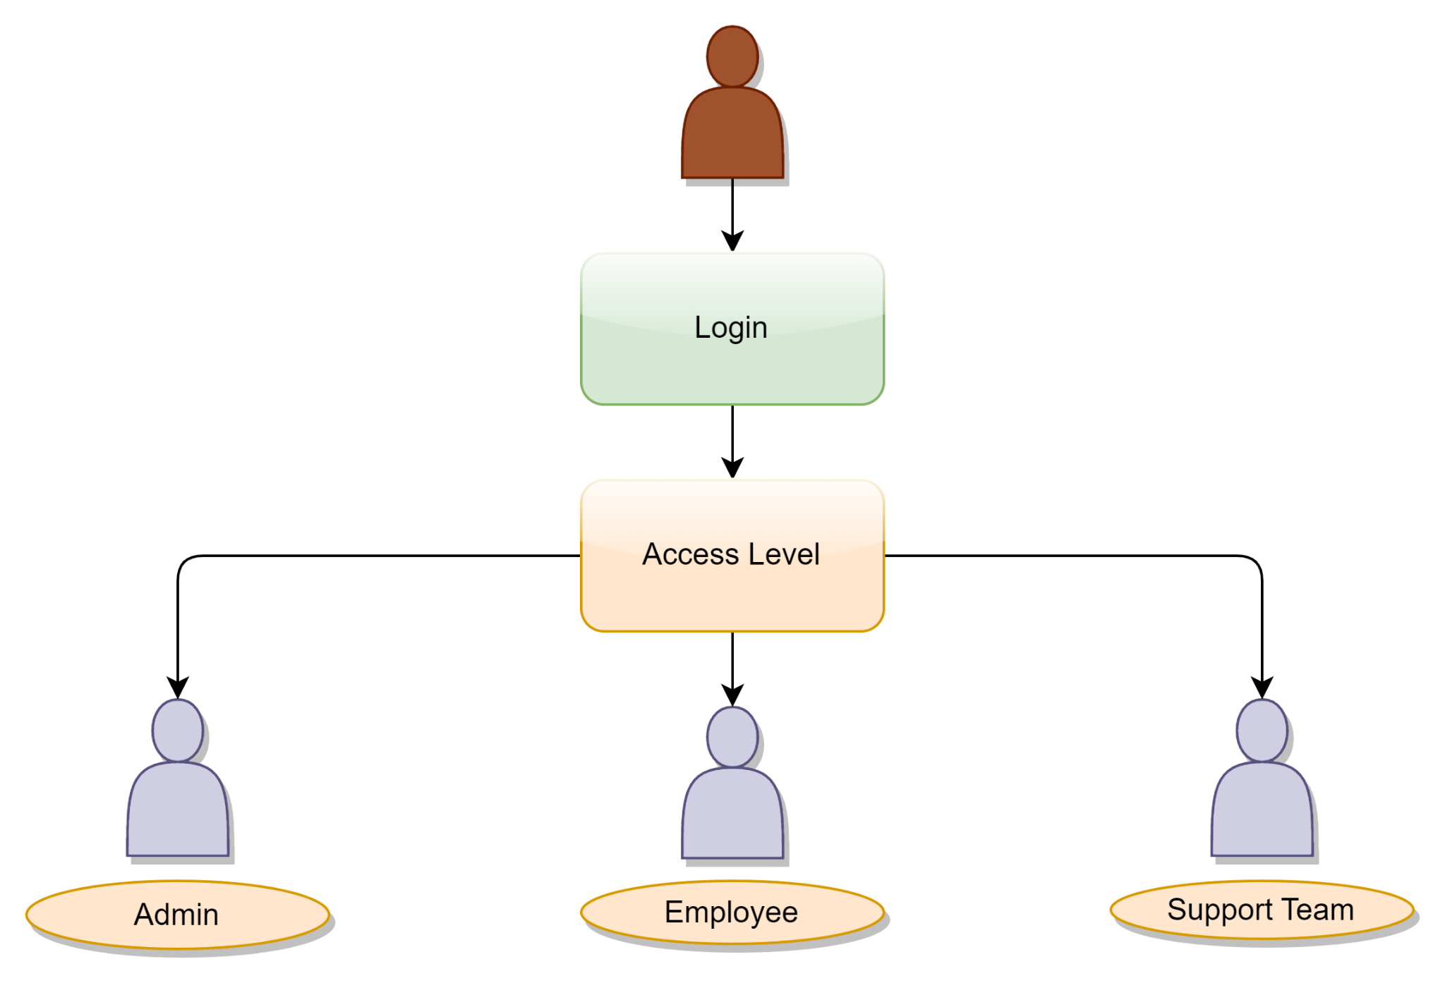
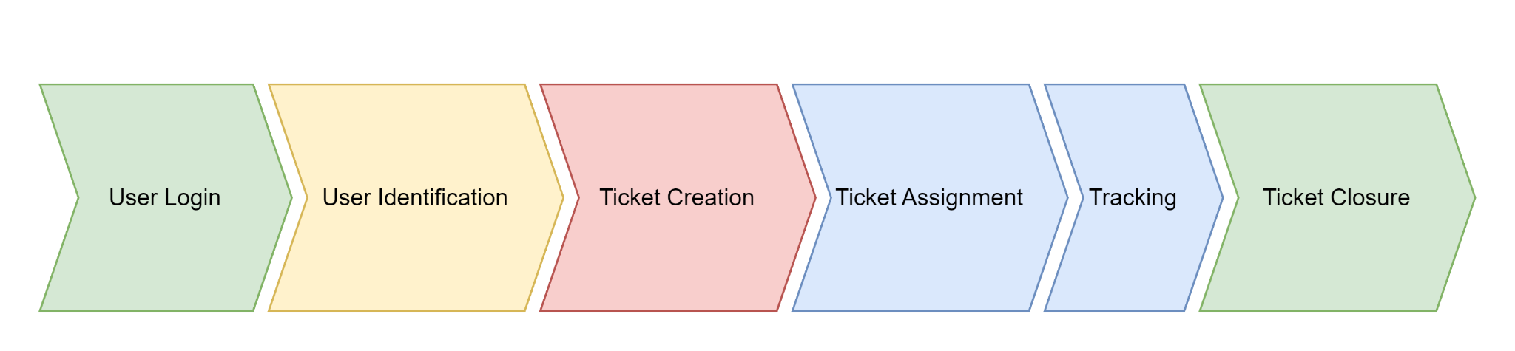
Access Level

Slide 12
Admin - Workflow
Login
Admin - Dashboard
All Tickets
Potential Subject
HR/Finance or Technical
Assignment
Projected timelines
Status of tickets
Review and approvals
Closure

Slide 13
Support Team - Workflow
Login
Support Team Dashboard
Assigned Tickets
Status of Tickets
Resolve or Recommend
Review & Approvals
Closure
Projected timelines

Slide 14
Technical Architecture
Notes:
Need to change

Slide 15









Technical Architecture
Key Features of the Architecture:
Can be deployed on On-premise or Cloud easily
Can be integrated with Oauth authentication & multi factor authentication
Modular and microservice based architecture - rapid fixes without downtime
Request
Users
Response
Client Layer
Web Server
Application Server
Database Server

Slide 16
Implementation
Notes:
Need to change

Slide 17





Implementation Plan
Assessment
Customization
Deployment
Evaluation
Adoption
Detailed Analysis of existing tools & software
Aligning requirements with the existing ticket management system
Listing Customizations and Enhancements
Customizing software to as per requirements
Adding additional features needed to align application with requirements.
Deploy Help Desk - Ticket management system
Configure security, workflows.
Configure alerts
Access setup for all users for evaluation
Training users on Help Desk tool
Access setup for all required users.

Slide 18
Security
Key Security Features
Security needs a multi-pronged approach to ensure no data or information is accessible to the wrong user
Infrastructure & Application
Secure infrastructure - Physical security, Network Security
Multi-factor authentication at every level - Admins, users
Encrypted data - Storage and transmission
Limited provision to download the data from either the database or the reports
No access to download PII information
Role based accesses
Roles and access controls defined for each module, ticket type, admin centers, configuration modules
Processes defined for adding and modifying users and accesses
Masked data to be default option unless specifically required for decision making.

Slide 19
Future Scope
Notes:
Need to change

Slide 20
Future Scope
1
2
3
4
AI Features
Training Models
Embedding Chat bot
Self Service Features
Alert Message Customization
Custom Sub workflows
Reports
Detailed report of each user.
Detailed report of all tickets
Security & Availability
Multi Factor Authentication
Data Backups

Slide 21
Q&A
Notes:
Need to change

